Slide 1
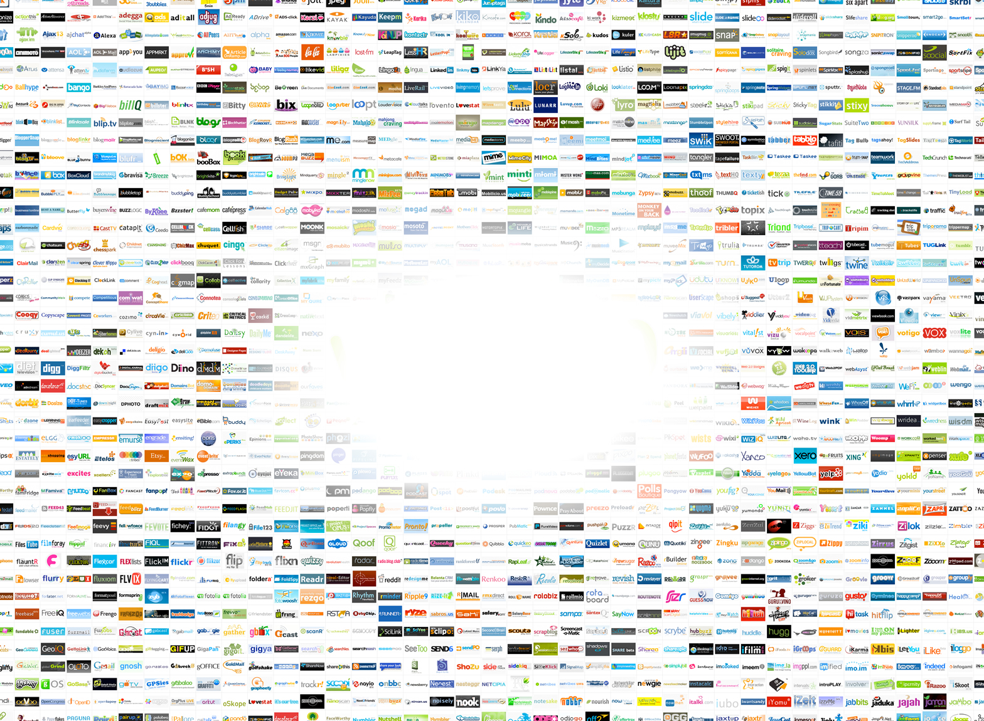
WEB 2.0. Una visión reflexiva
Web 2.0.
Una visión reflexiva

Slide 2
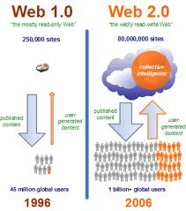
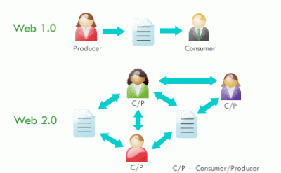
WEB 1.0 and WEB 2.0.
Notes:
If you say to you “web” or WWW you have an idea about what I am talking about… A place on Internet, full of information, links to computer aver the world… But If I say to you “social web or web 2.0.? What do you think It is… What ¡s the first idea that come to you… In other words What do you think is the main difference between web 1 and web 2? For example, Monica what do you think about?
Perfect, the main features is the possibility to publish information easyly. I mean without to much technical knowledge… Look at this pictures or diagrams:
In this first image you can see here, above, the published contents or the the web sites represented as a cloud… Here below you can see the web users … On the right you can see in web 2.0. the same… here the published contents and below the users There is a clear difference of amount of contents and number of users… Why ? Because in this first web only publish contents few people who has an specific technical content to do that. In this second kind of web, in web social you and me and almost everybody could publish information without more specific technical knowledge… Look at this second picture: you can see as In web 1.0. we have a person who produce contents and other one who access to this content. In the second web anyone can produce and access at the same time but also you can interact with information from other users creating a social network. It is the reason to call this web: social web. You could publish opinions or whatever you want related to an specific content, information, etc. And you could publish information because of I don’t need specific technical knowledge to do that. The web is made in a different way that web 1.
Web 2.0 describes World Wide Web sites that use technology beyond the static pages of earlier Web sites. The term was coined in 1999 by Darcy DiNucci and was popularized by Tim O'Reilly at the O'Reilly Media Web 2.0 conference in late 2004.^{[1][2]} Although Web 2.0 suggests a new version of the World Wide Web, it does not refer to an update to any technical specification, but rather to cumulative changes in the way Web pages are made and used.
A Web 2.0 site may allow users to interact and collaborate with each other in a social media dialogue as creators of user-generated content in a virtual community, in contrast to Web sites where people are limited to the passive viewing ofcontent. Examples of Web 2.0 include social networking sites, blogs, wikis, folksonomies, video sharing sites, hosted services, Web applications, and mashups.^{[3]}
Whether Web 2.0 is substantively different from prior Web technologies has been challenged by World Wide Web inventorSir Tim Berners-Lee, who describes the term as jargon.^{[4]} His original vision of the Web was "a collaborative medium, a place where we [could] all meet and read and write".^{[5][6]}

Slide 3
WEB 1.0 y WEB 2.0.
WEB 1.0 |  | WEB 2.0
1º fase | 2º fase | Se convierte en una plataforma de: Distribución de servicios Construcción de información Separación entre contenido y presentación Colaboración
Web informativa: Noticias Información específica | Aparición de servicios interactivos: Foros Serv.de mensajería e-banking

Slide 4
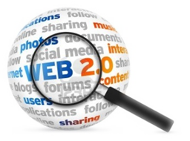
PRINCIPIOS
La web como plataforma
Aprovechamiento de la inteligencia colectiva
La gestión de la base de datos como competencia básica
El fin de las actualizaciones de software
Programación sencilla, búsqueda simplicidad
Software no limitado a un solo dispositivo

Slide 5
PRINCIPALES APLICACIONES

Slide 6
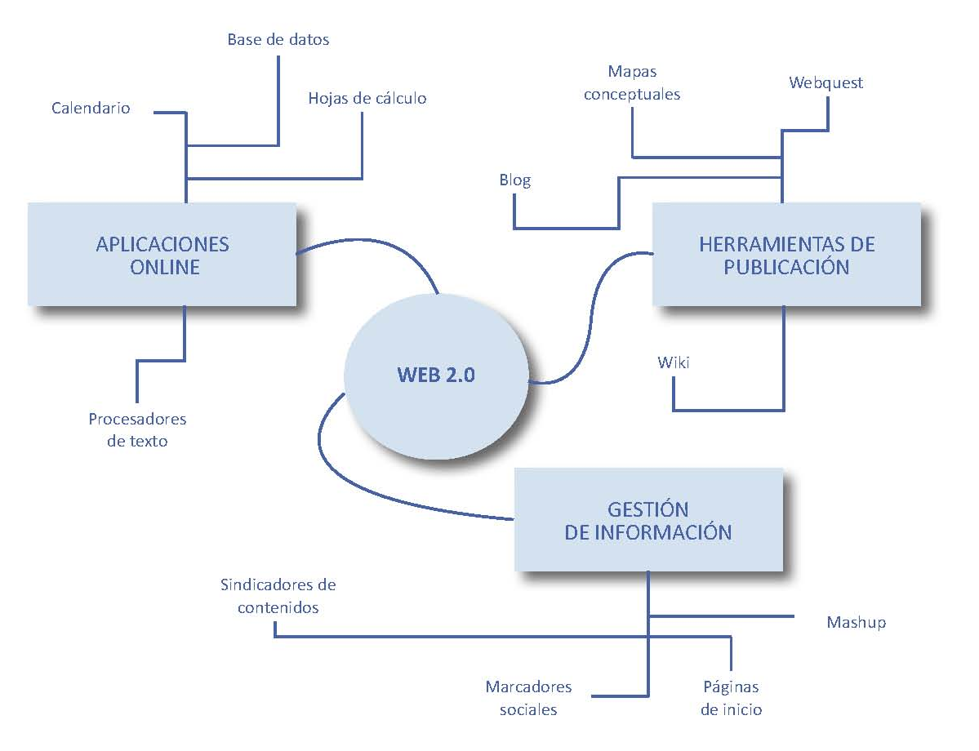
PRINCIPALES APLICACIONES

Slide 7
Usos educativos de Internet en los hogares de Cataluña (Mominó, Sigalés, Meneses et al, 2013)

